Slide 1
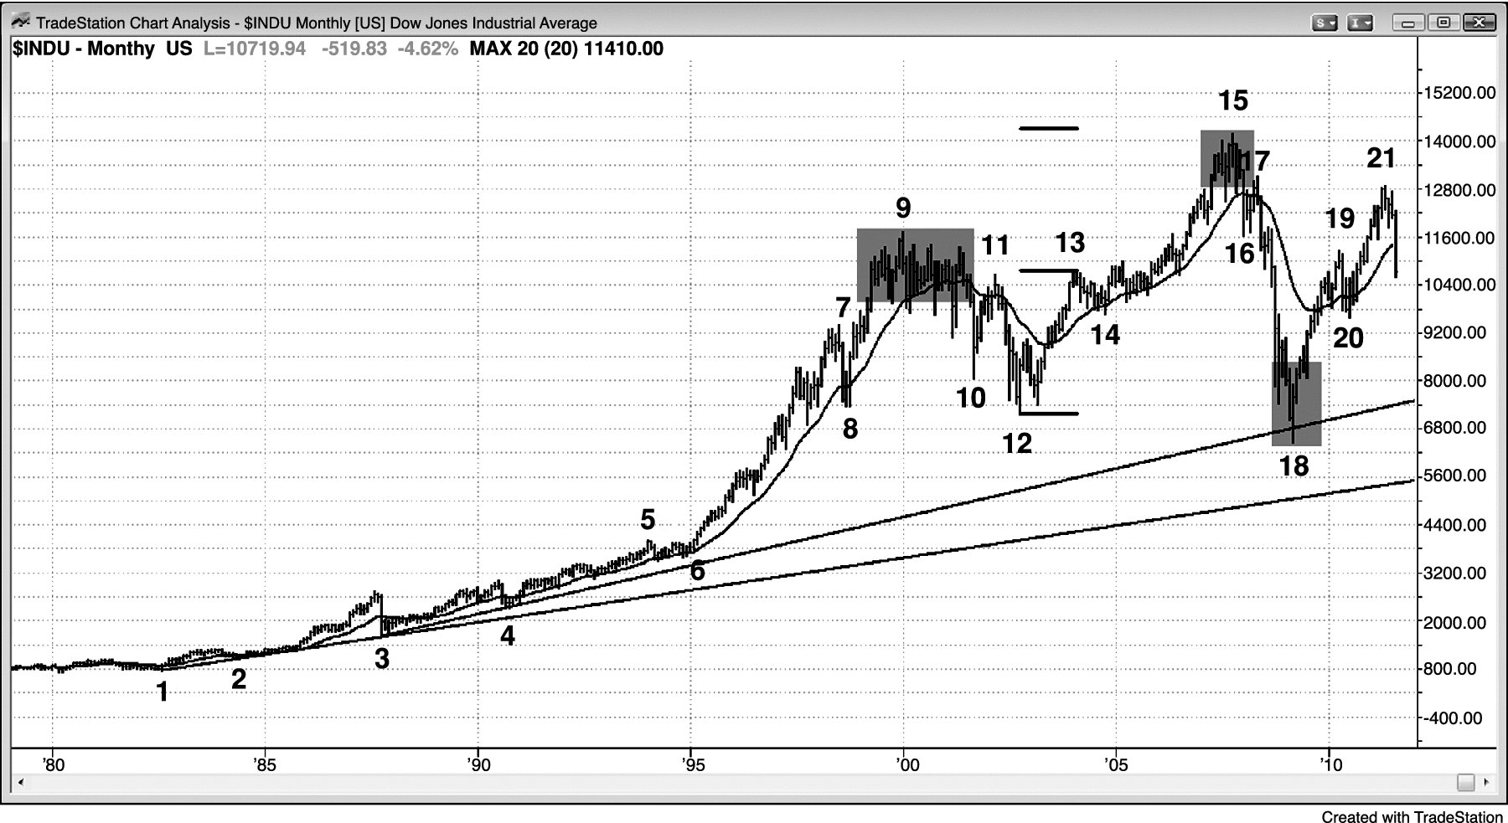
FIGURE PII.1 Dow Jones Industrial Average Monthly Chart

Slide 2
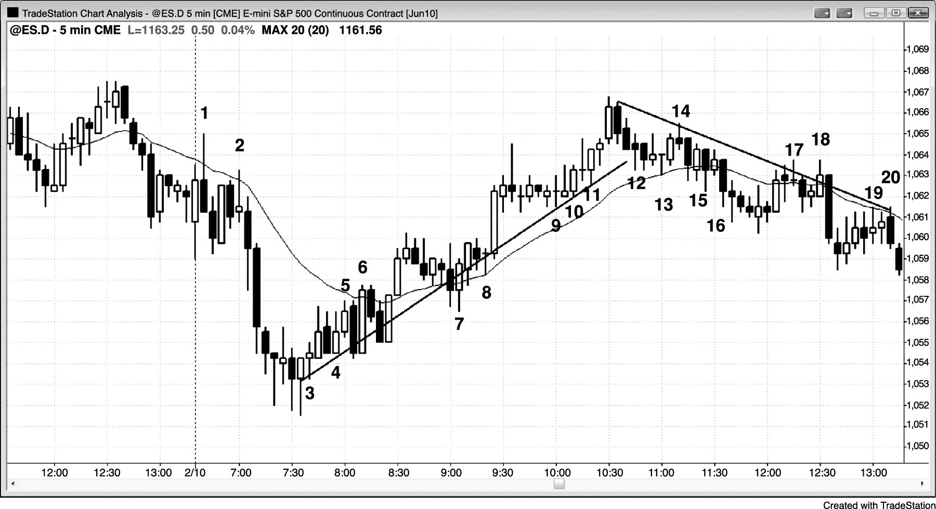
FIGURE PII.2 Support Can Become Resistance, and Resistance Can Become Support

